Slide 1

Department of Cyber Security 2026-2027- Odd Semester
III Year /V Sem
CS23533-FOUNDATIONS OF ARTIFICIAL INTELLIGENCE
Zeroth Review – dd.mm.yyyy

Slide 2
ADAPTIVE NETWORK TROUBLE SHOOTING AGENT
Batch Members:
ATHIRA M A (241901011)
AARJUN G (241901001)
Supervisor: Dr. S.Bhuvana
Assistant Professor [SG]

Slide 3
OUTLINE
Abstract
Objective
Literature Survey
Summary of Literature
Proposed System & Novelty
Block Diagram
Hardware/Software requirements
References

Slide 4
ABSTRACT
Modern computer networks are complex systems that require continuous monitoring and timely troubleshooting to maintain reliable connectivity and performance. Traditional network troubleshooting generally follows fixed procedures, predefined checklists, or depends heavily on the experience of network administrators. These methods can be time-consuming, inefficient, and may not always identify the most suitable sequence of actions for a specific network problem. To address these limitations, this project proposes an Adaptive Network Troubleshooting Agent that intelligently determines the most efficient troubleshooting path based on the symptoms and conditions of a network issue.
The proposed system combines Artificial Intelligence techniques, specifically A* Search and Forward Chaining, to automate and optimize the troubleshooting process. Forward chaining is used as a rule-based reasoning mechanism to analyse observed symptoms, such as packet loss, high latency, DNS failure, or connectivity issues, and infer possible causes of the problem. Based on these identified conditions, the A* Search algorithm explores the available troubleshooting actions and selects the most efficient path by considering the cost, time, and effectiveness of each action. The heuristic function helps the agent prioritize actions that are more likely to lead to the resolution of the problem while minimizing unnecessary diagnostic steps.
Unlike conventional troubleshooting methods that often follow a linear or static sequence of checks, the proposed agent adapts its troubleshooting path according to the current network condition and the results obtained from each diagnostic step. This saves troubleshooting time, and improves the efficiency of problem resolution. The system can also provide a clear explanation of the steps taken, making the troubleshooting process more understandable for users and beginner network administrators.
The main objective of this project is to develop an intelligent decision-support system capable of identifying possible network faults and recommending the most efficient sequence of troubleshooting actions. By integrating rule-based reasoning through Forward Chaining with optimal pathfinding using A* Search, the Adaptive Network Troubleshooting Agent aims to provide a faster, more systematic, and intelligent alternative to traditional network troubleshooting techniques. This approach demonstrates how Artificial Intelligence can be applied to network management and can serve as a foundation for developing more advanced autonomous network monitoring and troubleshooting systems.
KEYWORDS: Adaptive Network Troubleshooting, Rule-Based Expert System, Forward Chaining, A* Search Algorithm, Heuristic Search, Root Cause Analysis.

Slide 5
OBJECTIVE
To develop an Adaptive Network Troubleshooting Agent capable of identifying and resolving common network connectivity an3d performance
issues.
To implement Forward Chaining as a rule-based reasoning mechanism for analysing network symptoms and inferring possible causes of network faults.
To implement the A* Search algorithm for determining the most efficient sequence of troubleshooting actions based on network conditions.
To reduce troubleshooting time and eliminate unnecessary diagnostic steps by adapting the troubleshooting process according to the current network state.
To demonstrate the application of Artificial Intelligence techniques in network management using rule-based reasoning and heuristic search
methods.

Slide 6
Literature Survey
TITLE | YEAR | AUTHOR | TECHNIQUE
Fault Detection and Diagnosis in IP-based Mission Critical Industrial Process Control Networks | 2008 | Young J. Won, Mi-Jung Choi, James Won-Ki Hong, Myung-Sup Kim, Hwawon Hwang, Jun-Hyub Lee, Sung-Gyoo Lee | Network Fault Detection & Diagnosis
Fault Diagnosis Expert System Based on Integration of Neural Network and Fault Tree | 2009 | Yingying Wang | Expert System, Fault Tree Reasoning
Survey of Modern Fault Diagnosis Methods in Networks | 2017 | Zi Jian Yang, Yong Wang | Knowledge-Based Fault Diagnosis, Rule-Based Reasoning

Slide 7
EXISTING SYSTEM
Traditional network troubleshooting relies heavily on manual diagnosis performed by network administrators.
Most troubleshooting systems follow predefined procedures and fixed troubleshooting checklists.
Network faults are diagnosed sequentially, which increases the time required to identify the root cause.
Existing methods depend significantly on the knowledge and experience of skilled network professionals.
Conventional troubleshooting tools provide limited intelligent decision support during fault diagnosis.
The same troubleshooting sequence is often applied to different network problems, reducing efficiency.
Redundant diagnostic steps are frequently performed even when they are not necessary.
Existing systems do not automatically prioritize troubleshooting actions based on cost, time, or effectiveness.
Troubleshooting becomes increasingly difficult in large and complex network environments.
These approaches can result in longer network downtime, increased maintenance effort, and reduced overall troubleshooting efficiency.

Slide 8
PROPOSED SYSTEM
The proposed system is an Adaptive Network Troubleshooting Agent designed to intelligently identify and resolve common network connectivity and performance issues. The system uses Forward Chaining as a rule-based reasoning mechanism to analyse observed network symptoms and infer the most probable causes of faults. It applies the A* Search algorithm to determine the most efficient sequence of troubleshooting actions by considering factors such as cost, time, and effectiveness. The troubleshooting process is adaptive, allowing the agent to modify its diagnostic path according to the current network condition and the results obtained from previous troubleshooting steps. The system reduces redundant diagnostic actions and avoids unnecessary troubleshooting procedures, thereby improving the overall efficiency of fault resolution. It provides clear and systematic troubleshooting recommendations that help users understand the diagnosis process and perform corrective actions more effectively. The agent is capable of handling common network problems such as packet loss, high latency, DNS failure, and connectivity issues. By combining rule-based reasoning with heuristic search, the system offers intelligent decision support during network troubleshooting. The proposed system minimizes troubleshooting time by selecting the most suitable corrective action at each stage of the diagnostic process. It enhances troubleshooting accuracy by identifying the most relevant network fault based on observed symptoms. The integration of Forward Chaining and A* Search enables a structured and optimized troubleshooting workflow that is more effective than traditional manual methods. Overall, the proposed system provides a faster, more systematic, adaptive, and intelligent approach to network troubleshooting and can serve as a foundation for future autonomous network monitoring and troubleshooting systems.

Slide 9
Novelty in Proposed System
The novelty of the proposed Adaptive Network Troubleshooting Agent lies in its integration of rule-based fault diagnosis and heuristic path optimization within a single intelligent troubleshooting framework. Unlike conventional network troubleshooting systems that rely on fixed checklists, manual diagnosis, or static troubleshooting procedures, the proposed system dynamically adapts its troubleshooting sequence according to the current network condition. The combination of Forward Chaining and A Search* enables the system to identify probable network faults and simultaneously determine the most efficient sequence of corrective actions. This integration provides a structured decision-support mechanism that reduces unnecessary diagnostic operations and improves troubleshooting efficiency.
The proposed system introduces an adaptive troubleshooting strategy in which each diagnostic result influences the next troubleshooting action. Instead of following a predefined linear sequence, the system continuously updates the troubleshooting path based on intermediate observations, thereby minimizing redundant steps and reducing fault resolution time. The use of A Search allows troubleshooting actions to be prioritized
according to cost, time, and effectiveness*, which is generally absent in traditional network troubleshooting approaches. Furthermore, the system
provides transparent and explainable reasoning by showing how each inferred fault and recommended action is derived from the underlying rule base. This improves user understanding and makes the system suitable for educational and administrative environments.
The primary contribution of this project is the development of a lightweight Artificial Intelligence-based troubleshooting agent that does not depend on machine learning or historical training data. By integrating Forward Chaining with heuristic search in an adaptive decision-making framework, the proposed system offers a faster, more systematic, explainable, and optimized alternative to existing network
troubleshooting methods, making it a suitable foundation for future autonomous network management and intelligent fault diagnosis systems.

Slide 10
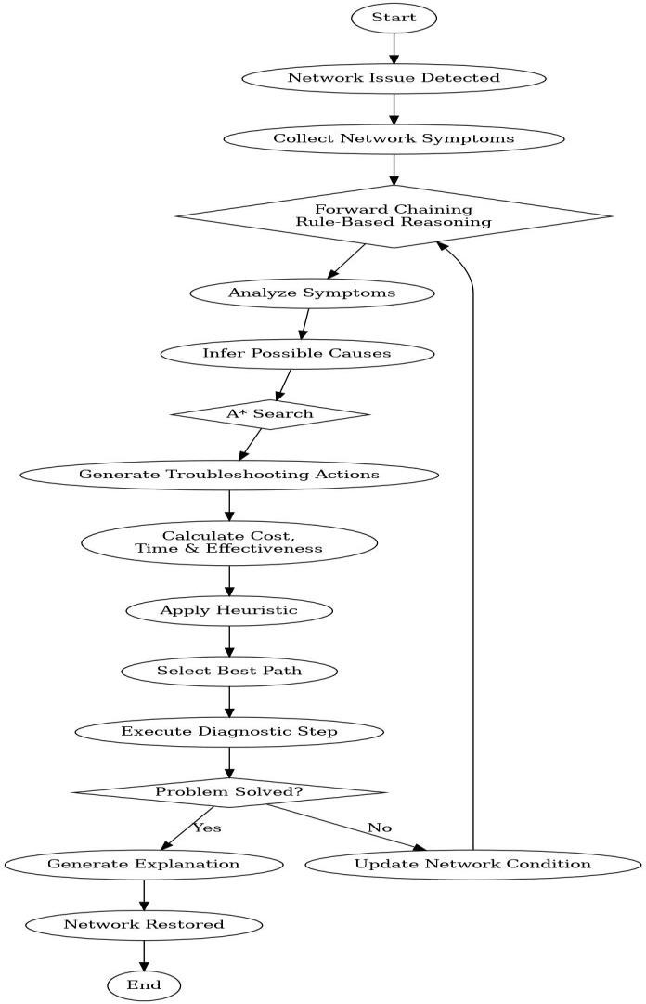
BLOCK DIAGRAM (PROPOSED SYSTEM)

Slide 11
Hardware/Software Requirements
Hardware Requirement:
Processor: Intel Core i3 or higher (Intel Core i5 recommended)
RAM: Minimum 4 GB (8 GB recommended)
Storage: Minimum 20 GB free disk space
Network: Wi-Fi or Ethernet connection for testing network diagnostics
Display: 1366 × 768 resolution or higher
Input Devices: Keyboard and Mouse
Software Requirement:
  Operating System: Windows 10/11
  Programming Language: Python 3.11 or later
  Development Environment: Visual Studio Code
  User Interface Framework: Streamlit
  Data Storage and Supporting Tools: JSON, Git and GitHub, and network diagnostic utilities (ping, traceroute/tracert, ipconfig/ifconfig, nslookup)

Slide 12
References
John Thornadtsson, Sania Partovian, Alessio Bucaioni. (2023). Analysis of Log Files to Enable Smart- Troubleshooting in Industry 4.0: A Systematic Mapping Study.
Diego Kreutz, Fernando M.V.Ramos, Paulo Esteves Verissimo. Christian Esteve Rothenberg, Siamak Azodolmolky, Steve Uhlig. (2015). Software Defined Networking: A Comprehensive Study

